Slide 1

Sustainability: which soap?

Slide 2

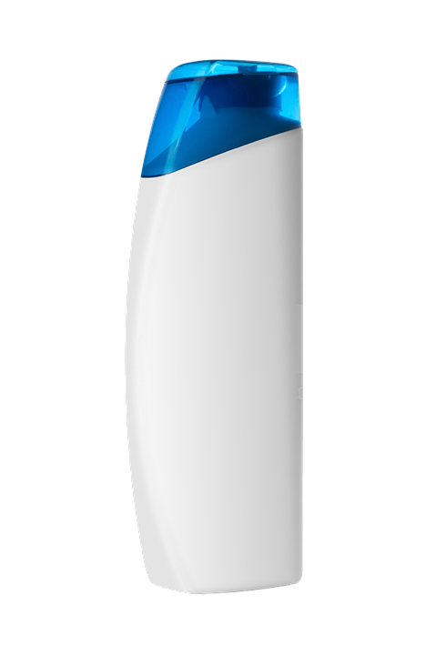
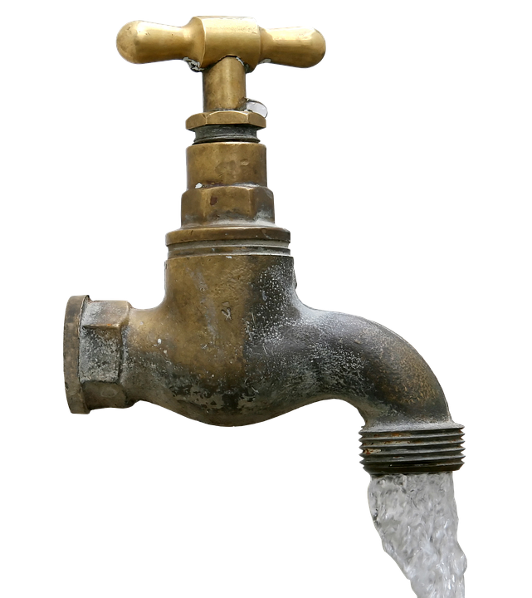
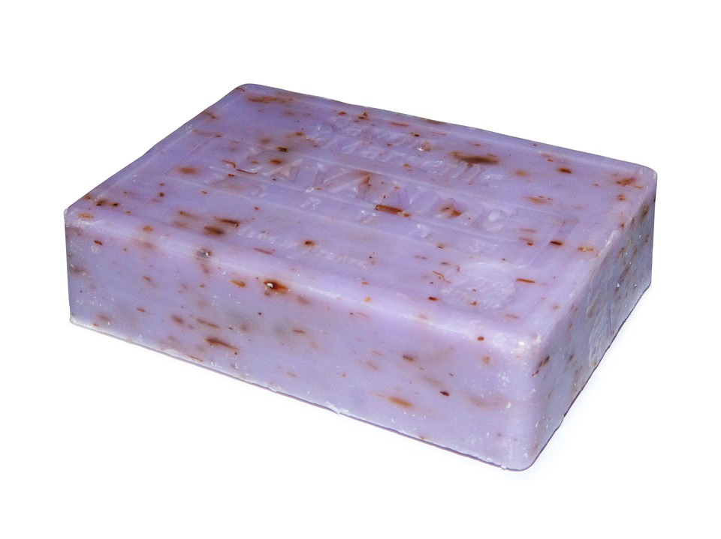
Which is the odd one out and why?
Bar of soap
water
Bottle of shampoo
Notes:
There is no one right answer so take as many as children are able to give, as long as they can give a reason.
Eg. water because it is free and you have to pay for the others
Water because you cannot use the other two without water
Water because it is clear
Soap because it is a solid
Soap because it does not take the shape of the container is put in
Soap because you cannot pour it
Shampoo because you don’t use it in school
Shampoo because you can use the other two to wash your hands but you usually only use shampoo to wash your hair.
Encourage children to start thinking about how the different states of matter affect how the products can be used. For example, soap can be easily transported and does not need a waterproof container whereas both shampoo and water are more difficult to transport.

Slide 3
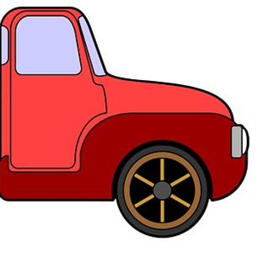
This liquid soap and the solid soap on this lorry would wash exactly the same number of hands.
Liquid
Soap
Solid Soap
For every lorry needed to carry a month’s supply of solid soap, it would take six and a half times as many lorries to carry a month’s supply of liquid soap!

Slide 4


www.ciec.org.uk

